Slide 1
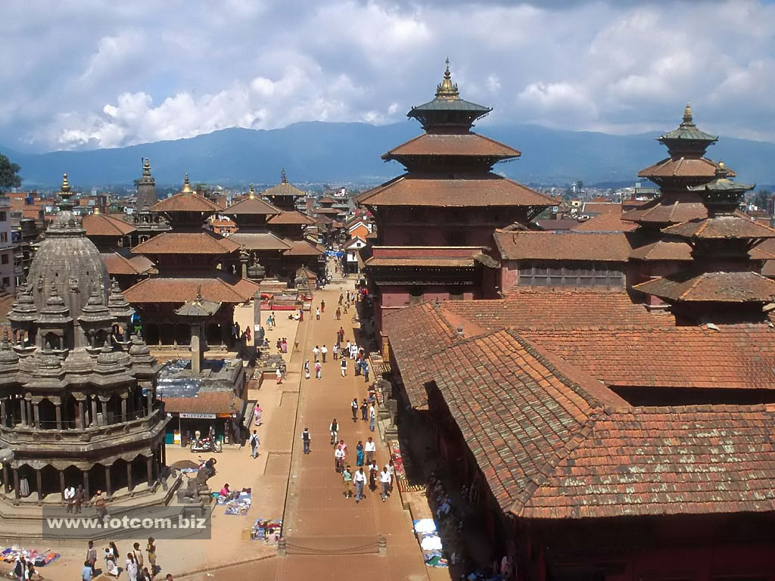
Visit 2019
Kathmandu, Nepal
Restaurant Hotel
Place to visit
Things to do

Slide 2
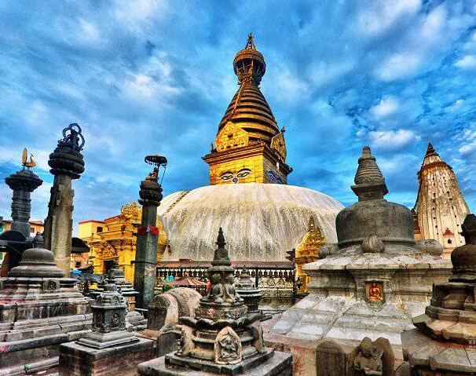
Kathmandu , Nepal
Nepal's capital is situated in a valley full of historic sites, ancient temples and shrines, golden pagodas and fascinating villages. Hotels, bars and restaurants cater to all budgets. Shops offer handicrafts, carpets and Nepali paper prints. Bus services, taxis and bicycles open up the city. Trek to see the Monkey Temple, the valley's oldest and most sacred shrine. Mingle with locals and animals amid Durbar Square's monuments and temples, or join mountain trekkers in the bustling Thamel District.

Slide 3
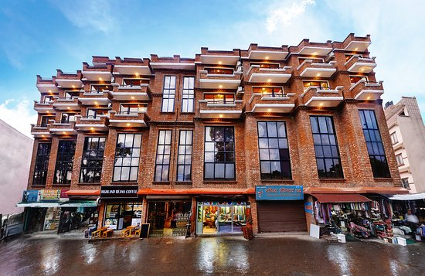
Restaurant and hotel in Kathmandu
Most booked. Aria Boutique Hotel & Spa. 4.5 stars. ...
DOM Himalaya Hotel. 4 stars. Fabulous 8.8 / 10. ...
Hotel Shanker. 4 stars. Very Good 8.4 / 10. ...
Hyatt Regency Kathmandu. 5 stars. Fabulous 8.6 / 10. ...
Hotel Yak & Yeti. 5 stars. ...
Hotel Shambala. 4 stars. ...
The Dwarika's Hotel. 5 stars. ...
Radisson Hotel Kathmandu. 5 stars.

Slide 4
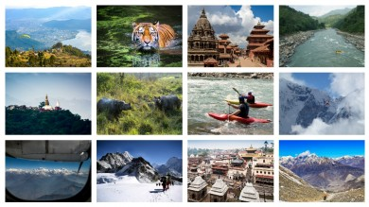
Things to do in Nepal
Trekking in Nepal. ...
Panoramic Flight Over the Himalayas. ...
Visit to Chitwan National Park. ...
Exploring Pokhara. ...
Mountain Biking in Kathmandu Valley and Nepal. ...
Kathmandu Sightseeing Tour. ...
Mount Everest Helicopter Tour. ...
Two Day River Rafting on the Bhote Koshi River.

